Slide 1
Lecture 2. Block Ciphers–Design and Structure
CSE 1204 Applied Cryptography
Lectures by Zhaxalykov T.M.

Slide 2
Agenda
Introduction to Block Ciphers
Design Principles: Confusion and Diffusion
Feistel Network Construction
Data Encryption Standard (DES)
Advanced Encryption Standard (AES)
Security Analysis and Cryptanalysis

Slide 3
1.Introduction to Block Ciphers
1.1 Definition and Characteristics
1.2 The Ideal Cipher Model
1.3 Security Goals for Block Ciphers

Slide 4
1.Introduction to Block Ciphers
Block ciphers constitute the foundation of modern symmetric cryptography, providing the core primitive for encrypting data at rest and in transit. This lecture examines the mathematical structure, design principles, and security properties of block ciphers.

Slide 5
1.1 Definition and Characteristics
Definition 1.1 (Block Cipher): A block cipher is a deterministic algorithm that operates on fixed-length groups of bits, called blocks, using a symmetric key. Formally, a block cipher is a family of permutations {Eₖ : {0,1}ⁿ → {0,1}ⁿ}ₖ∈𝒦, where n is the block size, 𝒦 is the key space, and for each key k ∈ 𝒦, the encryption function Eₖ is a bijection (permutation) with an efficiently computable inverse Dₖ = Eₖ⁻¹.

Slide 6
1.1 Definition and Characteristics
Key Properties:
Fixed Block Size: The cipher processes exactly n bits at a time. Common block sizes: 64 bits (DES, 3DES), 128 bits (AES), 256 bits (some modern ciphers).
Deterministic: Given the same plaintext block and key, the cipher always produces the same ciphertext block. This property necessitates careful mode of operation design (covered in Lecture 3).
Invertibility: Each encryption operation must be reversible using the same key. The permutation structure ensures no information loss.
Key-Dependent: Different keys produce different permutations. Security relies on the adversary not knowing which permutation (which key) is being used.

Slide 7
Example 1.1: Block Cipher as Permutation
Consider a toy block cipher with n = 4 bits and a simple key:
Plaintext: 0101 (decimal 5)
Key: 1011
Ciphertext: 1110 (decimal 14)
The cipher defines a permutation of the 2⁴ = 16 possible 4-bit values. A different key would produce a different permutation.

Slide 8
1.2 The Ideal Cipher Model
Definition 1.2 (Ideal Cipher): An ideal block cipher is one where each key k selects a uniformly random permutation from all (2ⁿ)! possible permutations of n-bit strings. To an adversary without knowledge of the key, the cipher output should be computationally indistinguishable from a random permutation.

Slide 9
1.2 The Ideal Cipher Model
For AES with n = 128, there are (2¹²⁸)! ≈ 2^(2¹³⁴) possible permutations, but only 2¹²⁸, 2¹⁹², or 2²⁵⁶ keys depending on key length. Real ciphers can only realize a tiny fraction of all possible permutations. Security relies on:
Computational Indistinguishability: The permutations realizable with different keys should appear random to polynomial-time adversaries.
Large Keyspace: Sufficient keys must exist to prevent exhaustive search. For n-bit security, at least 2ⁿ keys are needed.

Slide 10
1.3 Security Goals for Block Ciphers
A secure block cipher must satisfy two primary objectives:
Goal 1 (Pseudorandom Permutation Property): Given oracle access to Eₖ for a secret random key k, no efficient adversary can distinguish Eₖ from a uniformly random permutation π : {0,1}ⁿ → {0,1}ⁿ with probability significantly better than random guessing.
Goal 2 (Key Recovery Resistance): Given multiple plaintext-ciphertext pairs (Pᵢ, Cᵢ = Eₖ(Pᵢ)), no efficient adversary can recover the secret key k or compute Eₖ(P) for a new plaintext P with probability significantly better than exhaustive key search.

Slide 11
2.Design Principles: Confusion and Diffusion
2.1 Confusion
2.2 Diffusion
2.3 Combining Confusion and Diffusion

Slide 12
2.Design Principles: Confusion and Diffusion
Claude Shannon, in his seminal 1949 paper 'Communication Theory of Secrecy Systems,' identified two fundamental properties that cryptographic transformations should possess to resist statistical cryptanalysis: confusion and diffusion.

Slide 13
2.1 Confusion
Definition 2.1 (Confusion): Confusion refers to making the relationship between the ciphertext and the key as complex and involved as possible. Each bit of the ciphertext should depend on multiple parts of the key in a non-linear, unpredictable manner. Confusion obscures the relationship between key and ciphertext, preventing key recovery through statistical analysis.

Slide 14
2.1 Confusion
Implementation Techniques:
Substitution (S-boxes): Non-linear transformations that replace input values with output values according to a lookup table. S-boxes are carefully designed to resist linear and differential cryptanalysis.
Non-linear Operations: XOR alone is linear; confusion requires operations like modular addition, multiplication, or table lookups.
Key Mixing: Combining key material with data through complex operations ensures that changes in the key propagate unpredictably through the ciphertext.

Slide 15
Example 2.1: S-box Providing Confusion
Consider a 4-bit to 4-bit S-box:
Input: 0 1 2 3 4 5 6 7 8 9 A B C D E F
Output: E 4 D 1 2 F B 8 3 A 6 C 5 9 0 7
Input 0000 (0) maps to 1110 (E), input 0001 (1) maps to 0100 (4). This non-linear mapping obscures the relationship between input and output, providing confusion. Changing a single input bit can flip multiple output bits.

Slide 16
2.2 Diffusion
Definition 2.2 (Diffusion): Diffusion refers to spreading the influence of individual plaintext bits over many ciphertext bits, or equivalently, spreading the influence of a single ciphertext bit over many plaintext bits. Each bit of the plaintext should affect many bits of the ciphertext, and vice versa. Diffusion ensures that statistical properties of the plaintext (letter frequencies, patterns) are dissipated in the ciphertext.
The Avalanche Effect: A desirable property of block ciphers where changing a single bit of the plaintext or key should change approximately half of the ciphertext bits. This is a manifestation of good diffusion.

Slide 17
2.2 Diffusion
Implementation Techniques:
Permutation (P-boxes): Bit or byte transpositions that reorder data, spreading local changes across the entire block.
Linear Mixing: Operations like ShiftRows and MixColumns in AES that combine multiple bytes through linear transformations.
Multiple Rounds: Applying confusion and diffusion operations repeatedly amplifies their effect, ensuring complete diffusion after several rounds.

Slide 18
Example 2.2: Diffusion Through Permutation
Consider permuting 8 bits according to:
Position: 0 1 2 3 4 5 6 7 → Position: 3 6 1 4 7 2 5 0
Input: 10110001 → Output: 11011010
Bit 0 moves to position 7, bit 1 to position 2, etc. After several rounds combining permutation with substitution, a single bit flip in the input will affect multiple output bits.

Slide 19
2.3 Combining Confusion and Diffusion
Modern block ciphers achieve security by alternating confusion and diffusion operations across multiple rounds:
Confusion Layer: Apply non-linear substitutions (S-boxes) to introduce non-linearity and obscure key-ciphertext relationships.
Diffusion Layer: Apply permutations or linear mixing to spread the influence of each bit across the block.
Key Addition: Mix in round key material, typically through XOR.
Iteration: Repeat for r rounds. Each round amplifies the effects of confusion and diffusion, eventually achieving complete avalanche across the entire block.

Slide 20
3.Feistel Network Constructure
3.1 Feistel Structure
3.2 Decryption in Feistel Networks
3.3 Advantages of Feistel Construction

Slide 21
3.Feistel Network Constructure
The Feistel network, invented by Horst Feistel at IBM in the 1970s, provides an elegant framework for constructing block ciphers from simpler round functions. This design underpins DES and many other ciphers

Slide 22
3.1 Feistel Structure
Definition 3.1 (Feistel Network): A Feistel network is a symmetric structure for constructing a block cipher from a round function F. The block is divided into two equal halves (L, R). In each round i, one half is transformed using the round function with round key kᵢ, then XORed with the other half:
Lᵢ₊₁ = Rᵢ
Rᵢ₊₁ = Lᵢ ⊕ F(Rᵢ, kᵢ)
Key Insight: The Feistel structure is invertible regardless of whether the round function F is invertible. This allows the use of non-invertible, one-way functions as components.

Slide 23
3.2 Decryption in Feistel Networks
Theorem 3.1 (Feistel Invertibility): Decryption in a Feistel network uses the same structure as encryption but applies round keys in reverse order.
Proof: Given ciphertext (L_{r+1}, R_{r+1}) after r rounds, reverse round i by:
Rᵢ = Lᵢ₊₁
Lᵢ = Rᵢ₊₁ ⊕ F(Rᵢ, kᵢ) = Rᵢ₊₁ ⊕ F(Lᵢ₊₁, kᵢ)
The XOR operation is self-inverse: A ⊕ B ⊕ B = A. Thus, applying rounds in reverse order with the same keys recovers the original plaintext.

Slide 24
Example 3.1: Three-Round Feistel Cipher
Plaintext: (L₀ = 1010, R₀ = 1100)
Round function F(x, k) = (x ⊕ k) mod 16 (simplified)
Keys: k₁ = 0011, k₂ = 1001, k₃ = 0110
Round 1:
L₁ = R₀ = 1100
R₁ = L₀ ⊕ F(R₀, k₁) = 1010 ⊕ F(1100, 0011) = 1010 ⊕ 1111 = 0101
Round 2:
L₂ = R₁ = 0101
R₂ = L₁ ⊕ F(R₁, k₂) = 1100 ⊕ F(0101, 1001) = 1100 ⊕ 1100 = 0000
Round 3:
L₃ = R₂ = 0000
R₃ = L₂ ⊕ F(R₂, k₃) = 0101 ⊕ F(0000, 0110) = 0101 ⊕ 0110 = 0011
Ciphertext: (L₃ = 0000, R₃ = 0011)

Slide 25
3.3 Advantages of Feistel Construction
Identical Encryption/Decryption Structure: The same hardware or software can be used for both operations, reducing implementation complexity.
No Requirement for Invertible F: The round function need not be invertible, allowing greater flexibility in design. Complex, non-linear functions can be used.
Proven Framework: Many ciphers (DES, Blowfish, Twofish, Camellia) successfully employ this structure.
Security Analysis: Well-studied theoretical properties facilitate security evaluation.

Slide 26
4.Data Encryption Standard
4.1 DES Specifications
4.2 DES Algorithm Structure
4.3 DES Round Function F
4.4 DES Key Schedule
4.5 Security Analysis of DES

Slide 27
4.Data Encryption Standard
The Data Encryption Standard (DES), adopted by NIST in 1977, was the first publicly standardized block cipher. Despite being superseded by AES, DES remains pedagogically important for understanding block cipher design.

Slide 28
4.1 DES Specifications
Parameters:
Block Size: 64 bits
Key Size: 56 bits (stored in 64 bits with 8 parity bits)
Structure: 16-round Feistel network
Round Function: Complex combination of expansion, key mixing, S-box substitution, and permutation

Slide 29
4.2 DES Algorithm Structure
DES encryption proceeds as follows:
Initial Permutation (IP): Rearrange the 64 plaintext bits according to a fixed permutation table.
Feistel Rounds (16 iterations): Split the 64 bits into L₀ (32 bits) and R₀ (32 bits). For rounds i = 1 to 16, compute Lᵢ and Rᵢ using the Feistel structure with round function F.
Final Permutation (IP⁻¹): Apply the inverse of the initial permutation to produce the ciphertext.
Note: The initial and final permutations do not enhance security; they were included for hardware implementation considerations in the 1970s.

Slide 30
4.3 DES Round Function F
The DES round function F: {0,1}³² × {0,1}⁴⁸ → {0,1}³² takes the 32-bit right half Rᵢ and 48-bit round key kᵢ as inputs:
Expansion (E): Expand Rᵢ from 32 bits to 48 bits by duplicating some bits according to an expansion table. This provides diffusion and matches the round key length.
Key Mixing: Compute E(Rᵢ) ⊕ kᵢ (bitwise XOR with the round key).
S-box Substitution: Divide the 48 bits into eight 6-bit blocks. Pass each block through its corresponding S-box (S₁ through S₈). Each S-box maps 6 bits to 4 bits using a non-linear lookup table, providing confusion.
Permutation (P): Permute the 32 output bits from the S-boxes according to a fixed permutation table, providing diffusion.

Slide 31
Example 4.1: DES S-box Operation
Consider S-box S₁ with 6-bit input 011011:
Outer bits (row): 01 (binary) = 1 (decimal)
Inner bits (column): 1101 (binary) = 13 (decimal)
S₁[1][13] = 5 = 0101 (4-bit output)
The S-boxes are the only non-linear component in DES, providing crucial resistance to cryptanalysis. Their design criteria, initially secret, were later revealed to resist differential and linear cryptanalysis.

Slide 32
4.4 DES Key Schedule
The 56-bit key is transformed into sixteen 48-bit round keys k₁, k₂, ..., k₁₆ through the key schedule algorithm:
Permuted Choice 1 (PC-1): Permute the 56-bit key and split into two 28-bit halves C₀ and D₀.
Rotation: For each round i, perform left circular shifts on Cᵢ₋₁ and Dᵢ₋₁ by 1 or 2 positions (depending on round number) to produce Cᵢ and Dᵢ.
Permuted Choice 2 (PC-2): Select 48 bits from the concatenated CᵢDᵢ to form round key kᵢ.

Slide 33
4.5 Security Analysis of DES
Strengths:
Extensive Scrutiny: DES has been analyzed more thoroughly than any other cipher. Many attacks have been attempted, improving understanding of block cipher security.
Resistance to Known Cryptanalytic Techniques (at time of design): S-boxes were carefully designed to resist differential and linear cryptanalysis, though these techniques were not publicly known until the 1990s.
Good Avalanche Properties: After a few rounds, changing one input bit affects approximately half of the output bits.

Slide 34
4.5 Security Analysis of DES
Critical Weakness:
Insufficient Key Length: With only 2⁵⁶ ≈ 7.2 × 10¹⁶ possible keys, exhaustive search became practical in the late 1990s. The EFF Deep Crack machine (1998) could break DES in 56 hours. Modern hardware (GPUs, ASICs, FPGAs) can break DES in hours or minutes.
Conclusion: DES is no longer secure for modern applications. It has been superseded by Triple DES (3DES) and AES. However, DES remains important as a teaching example and historical milestone in cryptography.

Slide 35
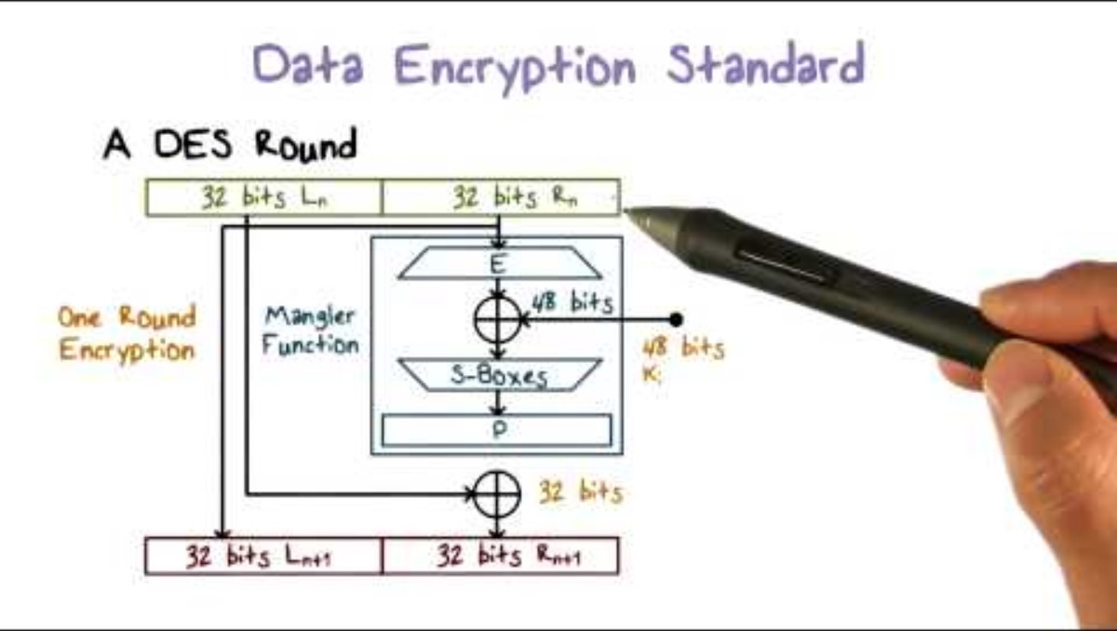

Slide 36
5.Advanced Encryption Standard
5.1 AES Specifications
5.2 AES State Representation
5.3 AES Round Transformation
5.4 AES Encryption Algorithm
5.5 AES Key Schedule
5.6 Why AES is Considered Secure

Slide 37
5.Advanced Encryption Standard
The Advanced Encryption Standard (AES), adopted by NIST in 2001, replaced DES as the standard symmetric encryption algorithm. AES was selected through an open competition won by the Rijndael cipher designed by Joan Daemen and Vincent Rijmen.

Slide 38
5.1 AES Specifications
Parameters:
Block Size: 128 bits (fixed)
Key Sizes: 128, 192, or 256 bits
Rounds: 10 (AES-128), 12 (AES-192), or 14 (AES-256)
Structure: Substitution-Permutation Network (SPN), not Feistel

Slide 39
5.2 AES State Representation
AES organizes the 128-bit block as a 4×4 matrix of bytes called the state array:
[ s₀,₀ s₀,₁ s₀,₂ s₀,₃ ]
[ s₁,₀ s₁,₁ s₁,₂ s₁,₃ ]
[ s₂,₀ s₂,₁ s₂,₂ s₂,₃ ]
[ s₃,₀ s₃,₁ s₃,₂ s₃,₃ ]
Each sᵢ,ⱼ is an 8-bit byte. Bytes are filled column-wise from the input block.

Slide 40
5.3 AES Round Transformations
Each AES round (except the last) applies four transformations to the state:
SubBytes (Confusion)
ShiftRows (Diffusion)
MixColumns (Diffusion)
AddRoundKey (Key Mixing)

Slide 41
5.3.1 SubBytes (Confusion)
Definition: SubBytes is a non-linear byte substitution applied independently to each byte of the state using a fixed 8-bit S-box. The S-box is constructed using the multiplicative inverse in GF(2⁸) followed by an affine transformation.
For each byte sᵢ,ⱼ: sᵢ,ⱼ ← S-box[sᵢ,ⱼ]
The AES S-box provides strong non-linearity, resisting linear and differential cryptanalysis. It has no fixed points (S[x] ≠ x for all x) and excellent differential uniformity.

Slide 42
5.3.2 ShiftRows (Diffusion)
Definition: ShiftRows cyclically shifts the bytes in each row of the state to the left by a row-dependent offset:
Row 0: No shift
Row 1: Shift left by 1 byte
Row 2: Shift left by 2 bytes
Row 3: Shift left by 3 bytes
This transposition provides inter-column diffusion, ensuring that bytes from different columns mix in subsequent operations.

Slide 43
5.3.3 MixColumns (Diffusion)
Definition: MixColumns applies a linear transformation to each column of the state independently. Each column is treated as a polynomial over GF(2⁸) and multiplied by a fixed polynomial c(x) = 03x³ + 01x² + 01x + 02 modulo x⁴ + 1.
Matrix form: Each column [s₀, s₁, s₂, s₃]ᵀ is transformed by multiplying with the fixed matrix:
[ 02 03 01 01 ] × [ s₀ ]
[ 01 02 03 01 ] × [ s₁ ]
[ 01 01 02 03 ] × [ s₂ ]
[ 03 01 01 02 ] × [ s₃ ]
All operations are in GF(2⁸). This ensures maximum distance between any input and output, guaranteeing that each output byte depends on all four input bytes of the column.

Slide 44
5.3.4 AddRounadKey (Key Mixing)
Definition: AddRoundKey XORs the current state with the round key derived from the key schedule:
sᵢ,ⱼ ← sᵢ,ⱼ ⊕ kᵢ,ⱼ⁽ʳᵒᵘⁿᵈ⁾
This simple operation introduces key dependency while maintaining reversibility (XOR is its own inverse).

Slide 45
5.4 AES Encryption Algorithm
Complete AES-128 encryption (10 rounds):
Initial Round: AddRoundKey (with key schedule word w[0...3])
Main Rounds (rounds 1-9): SubBytes → ShiftRows → MixColumns → AddRoundKey
Final Round (round 10): SubBytes → ShiftRows → AddRoundKey (no MixColumns)
The final round omits MixColumns because it would not add security (the attacker can simply apply the inverse MixColumns operation).

Slide 46
5.5 AES Key Schedule
The key schedule expands the input key into multiple round keys. For AES-128 with 10 rounds, 11 round keys are needed (one for initial AddRoundKey, ten for main rounds), each 128 bits, totaling 44 32-bit words.
Key Expansion Algorithm:
Initialize: The first four words w[0], w[1], w[2], w[3] are taken directly from the 128-bit input key.
Iteration: For i = 4 to 43, compute w[i] based on w[i-1] and w[i-4]. Every fourth word (i mod 4 = 0) undergoes a special transformation involving RotWord (circular left shift), SubWord (S-box application), and XOR with a round constant Rcon[i/4].
Otherwise: w[i] = w[i-1] ⊕ w[i-4].
The key schedule introduces non-linearity (through SubWord) and ensures that each round key depends on the master key in a complex manner, preventing related-key attacks.

Slide 47
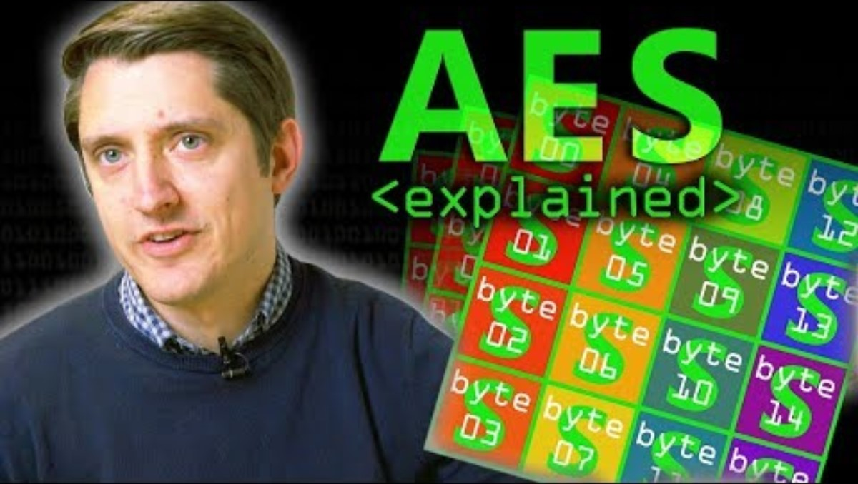

Slide 48
5.6 Why AES is Considered Secure
Large Keyspace: AES-128 has 2¹²⁸ ≈ 3.4 × 10³⁸ keys, far beyond brute-force capability. AES-256 provides 2²⁵⁶ keys for extreme long-term security.
Strong Resistance to Known Attacks: No practical attack on full-round AES has been discovered. The best academic attacks (biclique attack, related-key attacks) only work in unrealistic scenarios or reduce security marginally.
Mathematical Foundation: AES operations in GF(2⁸) provide provable properties like optimal branch numbers for MixColumns, ensuring strong diffusion.
Extensive Analysis: AES has undergone 20+ years of intensive cryptanalysis by the global research community. It is the most studied cipher in history.
Hardware Efficiency: Modern CPUs include AES-NI instructions for hardware-accelerated encryption, achieving throughput of multiple GB/s.

Slide 49
6. Security Analysis and Cryptanalysis
6.1 Brute Force Attack
6.2 Linear Cryptanalysis
6.3 Differential Cryptanalysis
6.4 The Limits of Security Proofs

Slide 50
6.1 Brute Force Attacks
Definition 6.1 (Exhaustive Key Search): A brute force attack systematically tries all possible keys until the correct one is found. For a cipher with k-bit keys, the expected number of trials is 2^(k-1), and the worst case is 2^k trials.
Computational Feasibility:
DES (56-bit key): 2⁵⁶ ≈ 7.2 × 10¹⁶ operations. Modern GPU can test ~10⁹ keys/second, breaking DES in hours.
AES-128 (128-bit key): 2¹²⁸ ≈ 3.4 × 10³⁸ operations. Even with 10¹⁵ operations/second (unrealistic), would require >10¹⁵ years.
AES-256 (256-bit key): 2²⁵⁶ ≈ 1.2 × 10⁷⁷ operations. Absolutely infeasible with foreseeable technology.
Conclusion: Proper key length makes brute force attacks computationally infeasible. A minimum of 128 bits is recommended for long-term security against classical computers.

Slide 51
6.2 Linear Cryptanalysis
Definition 6.2 (Linear Cryptanalysis): A known-plaintext attack that exploits linear approximations of the cipher's behavior. The attacker finds a linear equation relating plaintext bits, ciphertext bits, and key bits that holds with probability p ≠ 0.5.
Discovered by Mitsuru Matsui in 1993, linear cryptanalysis was the first theoretical attack better than brute force for DES. For a linear approximation with bias ε = |p - 0.5|, approximately 1/ε² known plaintexts are required.
Example: If a linear approximation holds with probability p = 0.75 (bias ε = 0.25), then 1/(0.25)² = 16 plaintext-ciphertext pairs are needed theoretically.
Defense: Modern S-boxes (AES, DES) are designed to have low linear approximation bias, requiring an impractical number of plaintexts for linear cryptanalysis.

Slide 52
6.3 Differential Cryptanalysis
Definition 6.3 (Differential Cryptanalysis): A chosen-plaintext attack that analyzes how differences in plaintext pairs propagate through the cipher to produce differences in ciphertext pairs. The attacker seeks differential characteristics (input difference → output difference) that occur with high probability.
Discovered by Eli Biham and Adi Shamir in 1990, differential cryptanalysis exploits non-uniform difference distributions in S-boxes. By observing many pairs with specific input differences, the attacker gains information about key bits.
Defense: The DES S-boxes were specifically designed to resist differential cryptanalysis (though this was not public knowledge until the 1990s). AES resists differential cryptanalysis through the wide trail strategy: the combination of ShiftRows and MixColumns ensures that any non-zero difference activates many S-boxes in subsequent rounds, preventing high-probability differential paths.

Slide 53
6.4 The Limits of Security Proofs
An important caveat: Unlike some cryptographic constructions (e.g., provable security of certain encryption modes from block cipher security), we cannot prove that AES or any practical block cipher is secure in an absolute sense.
Theorem 6.1 (Informal - Limits of Block Cipher Security Proofs): There is no known method to prove that a practical block cipher (like AES) is secure without relying on unproven assumptions. Security claims are based on:
Failure of all known attacks: No successful attack has been found despite extensive cryptanalysis.
Provable lower bounds on specific attacks: For example, the wide trail strategy in AES provides lower bounds on the number of active S-boxes in differential and linear attacks.
Heuristic design principles: Confusion, diffusion, sufficient rounds, large keyspace.
This contrasts with cryptographic constructions whose security can be reduced to hard mathematical problems (e.g., RSA security based on integer factorization). Block cipher security relies on empirical confidence accumulated through years of failed attack attempts.

Slide 54
Conclusion
This lecture has provided a comprehensive introduction to block cipher design and analysis. Key concepts covered include:
Block ciphers as keyed permutations operating on fixed-length blocks, fundamental to modern symmetric cryptography.
Shannon's principles of confusion and diffusion as the foundation for secure cipher design.
Feistel networks as an elegant construction enabling invertibility from non-invertible round functions.
DES as a historical milestone demonstrating both the success of standardization and the critical importance of sufficient key length.
AES as the current standard, combining mathematical elegance with practical efficiency and strong security.
Cryptanalytic techniques (linear, differential) and the empirical nature of block cipher security.

Slide 55
Practical Implications
For practitioners implementing cryptographic systems:
Use AES: It is the gold standard for symmetric encryption. Use AES-128 for most applications, AES-256 for long-term security.
Avoid Obsolete Ciphers: Never use DES for new applications. Use 3DES only for legacy compatibility where absolutely necessary.
Don't Invent Your Own: Block cipher design is extremely difficult. Use standardized, well-analyzed ciphers rather than creating custom solutions.
Block Cipher ≠ Complete Solution: Block ciphers alone are insufficient. Next lecture covers modes of operation, which address how to encrypt data longer than one block and other practical requirements.

Slide 56
Looking Forward
Next Lecture (Week 3): Block Cipher Modes of Operation. We will study how to apply block ciphers to encrypt messages of arbitrary length, addressing the limitations of processing fixed-size blocks. Topics include ECB, CBC, CTR, and their security properties. We will demonstrate the catastrophic failure of ECB mode and the importance of initialization vectors.

Slide 57
Preparation for Next Lecture
Read Ferguson et al., Chapter 4: Block Cipher Modes
Read Aumasson, Chapter 5: Stream Ciphers (CTR mode section)
Read Rosulek, Chapters 7-8: CPA-Secure Encryption
Lab: Implement AES encryption/decryption using a cryptographic library. Measure performance. Begin Lab 1 preparation.

Slide 58
Thank you for attention !!!

